Slide 1


Predicting BMW Car Sales Using Machine Learning
Alyssa Graham
Notes:
Hello! My name is Alyssa Graham, and today I’ll be presenting my project on predicting BMW car sales using machine learning. The goal of this project is to identify which vehicle features best predict whether a BMW listing will achieve high sales performance.

Slide 2


Business Problem
Car Market is Highly Competitive
Sellers should understand what features drive sales
Key Question: What characteristics best predict if a BMW car will sell?
Goal: Support dealers by highlighting high-impact vehicle features
Notes:
The car market, both new and used, is highly competitive. Dealers and private sellers need insights into what drives sales. Our main question was: What characteristics best predict if a BMW car will sell? By answering this, we can help sellers focus on the most important features when marketing vehicles

Slide 3

Background
BMW: known for innovation and engineering
Sales success varies by model features
Historic trends show how feature combinations affect performance
Machine Learning can uncover hidden patter in data
Notes:
BMW is a globally recognized automotive brand known for innovation and engineering excellence. Sales success varies across models and configurations. Some features—like model type, transmission, or engine size—have historically had more influence on buyer decisions. The goal here was to use historical sales data to find these patterns and help sellers improve sales rates.

Slide 4

Dataset Overview
Source:
Kaggle
50,000 data points
BMW listings
Features:
Model
Year
Milage
Fuel Type
Engine Size
Price
Sales Classification
Preprocessing:
Removes Duplicates & Missing Data
Label Encoded Categorical Variables
Detected Outlies with EDA
Notes:
The dataset came from Kaggle and contains 50,000 BMW listings. It includes features such as model, year, mileage, fuel type, engine size, price, and sales classification. Before analysis, I cleaned the data—removing duplicates and missing values, label encoding categorical features, and conducting exploratory data analysis to identify outliers.

Slide 5

Methods
Supervised Classification:
Binary Target – “High” vs “Low” sales
Label Encoding for Categorical Features
80/20 Train-Test Split
Models Used:
Logistic Regression
Random Forest Classifier
XGBoost Classifier
Notes:
This was a supervised classification task. The target variable was a binary label: ‘High’ or ‘Low’ sales classification. Categorical variables were label-encoded, and the data was split into 80% training and 20% testing sets. I trained three models: Logistic Regression, Random Forest Classifier, and XGBoost Classifier.

Slide 6
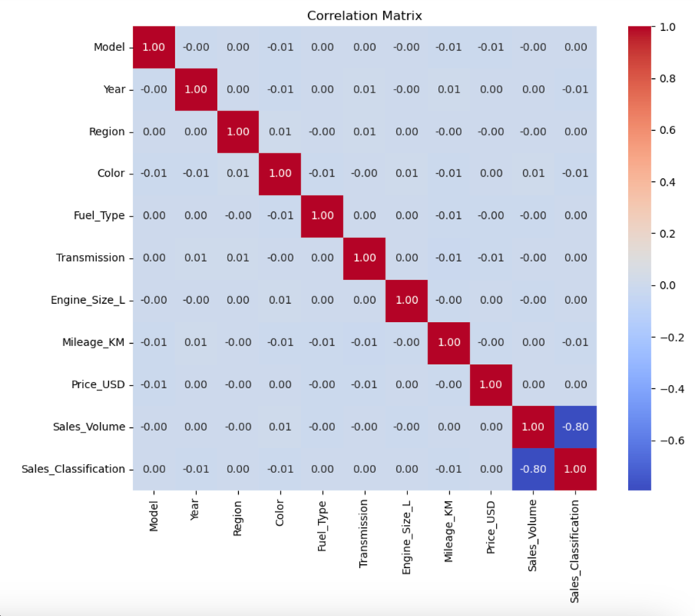

Correlation Matrix
Shows relationships between numeric variables
Key Observations:
Strong Positive Correlation
Sales Volume vs Sales Class → excluded to prevent leakage
Weak Negative Correlation
Milage vs Sales Class
Weak Positive Correlation
Prive vs Sales Class
See Figure 1
Notes:
Before jumping into modeling, I wanted to see how the numerical features relate to each other and to the target variable — sales classification. This correlation matrix measures the strength and direction of linear relationships between features, with values ranging from -1 to +1.
We can see a very strong positive correlation between Sales Volume and Sales Classification, which is expected — more popular cars tend to sell better. However, because sales volume is essentially a direct measure of popularity, leaving it in the model would cause data leakage. That means the model could ‘cheat’ by using a variable that directly encodes the answer, so I removed it from modeling.
Next, Price shows only a weak positive correlation with Sales Classification. This tells us that price by itself isn’t a strong predictor — likely because its impact depends on other factors like mileage, model, and year.
Mileage shows a weak negative correlation, meaning that as mileage increases, the likelihood of a ‘High’ sales classification decreases. This is intuitive — lower mileage is usually more attractive to buyers.
While this matrix doesn’t tell the whole story, it helps identify potential predictors and spot multicollinearity issues, which can be important for some models like Logistic Regression.

Slide 7
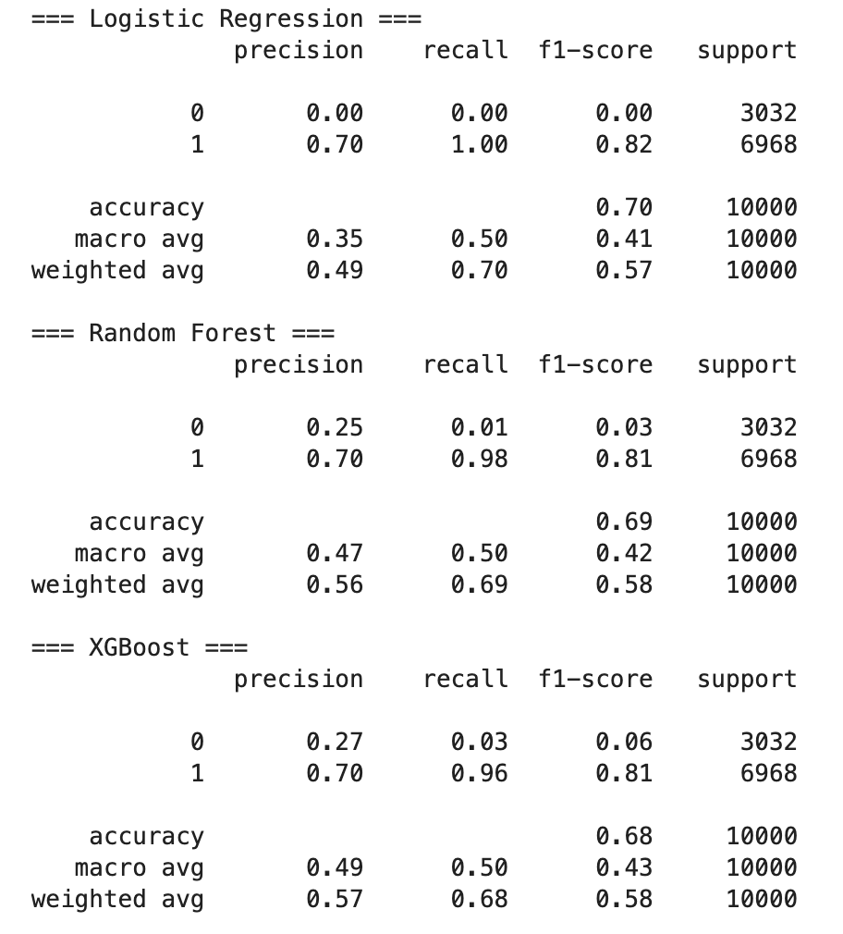

Logistic Regression
Baseline model using linear relationship
Accuracy: 0.70
All predictions classified as “High”
Poor recall for “Low” sales class due to class imbalance
Overly simplistic for real-world data
See Figure 2
Notes:
Logistic Regression served as my baseline model. It’s a relatively simple classification algorithm that estimates the probability of a car being in the ‘High’ or ‘Low’ sales category, assuming a linear relationship between the features and the log-odds of the outcome.
The model achieved 70% accuracy, which sounds good at first glance — but when I looked at the predictions, every single test listing was classified as ‘High’. That means it had zero recall for the ‘Low’ sales category. The reason? Class imbalance. The dataset had far more ‘High’ listings than ‘Low’, so the model defaulted to predicting the majority class.
This result is a good reminder that accuracy alone can be misleading in imbalanced datasets. The Logistic Regression model was simply too simplistic for the complexity of real-world car sales, where relationships between features aren’t purely linear.

Slide 8
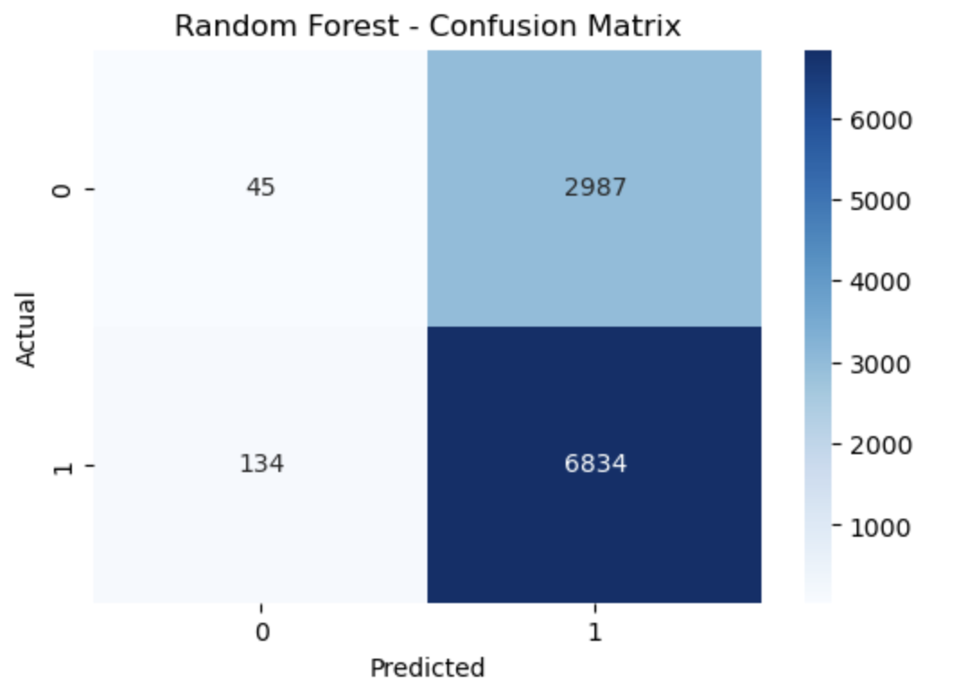
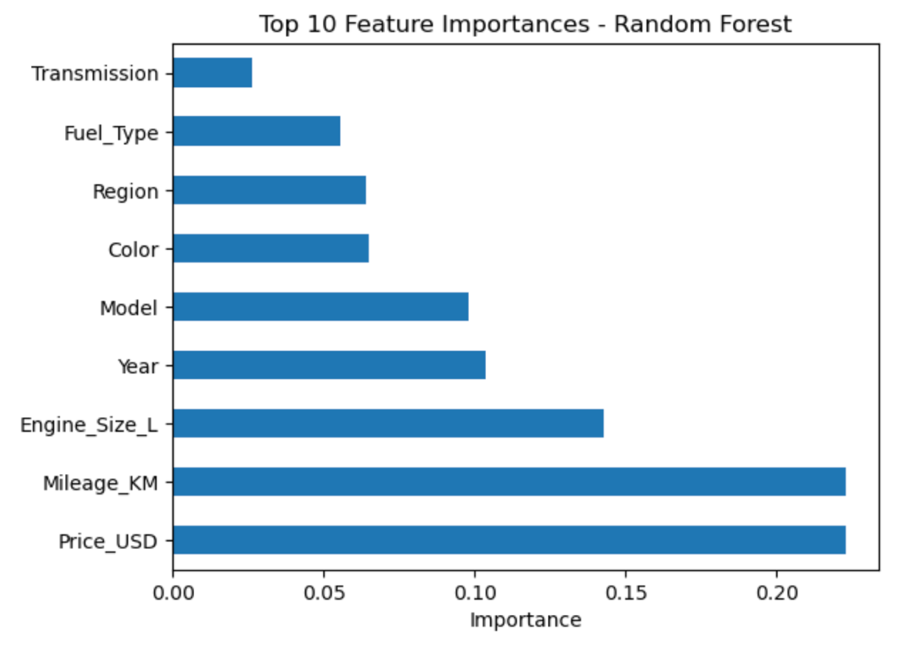

Random Forest Results
Captures non-linear relationships
Accuracy: 0.69
Still favors “High” sales class but improved recall
Top Features:
Price
Milage
Engine Size
See Figures 3 & 4
Notes:
Random Forest is an ensemble method that builds many decision trees and averages their results. This approach captures non-linear patterns and interactions between features, which makes it more robust for a dataset like this.
The model achieved 69% accuracy — slightly lower than Logistic Regression’s accuracy, but it did a better job at capturing some ‘Low’ sales cases. Recall for the ‘Low’ class was still not ideal, but it was a step in the right direction.
The feature importance chart reveals that Price, Mileage, and Engine Size were the top predictors.
Price: Certain price points are more attractive to buyers, and pricing strategy can influence sales performance.
Mileage: Lower mileage typically signals less wear and tear, making the car more desirable.
Engine Size: Larger engines may appeal to performance-focused buyers, while smaller engines might appeal to those seeking efficiency.
The business takeaway here is that dealerships can prioritize marketing efforts on competitively priced, low-mileage vehicles with popular engine configurations. Random Forest also provides interpretable insights into why the model is making predictions, which is valuable for sales teams

Slide 9
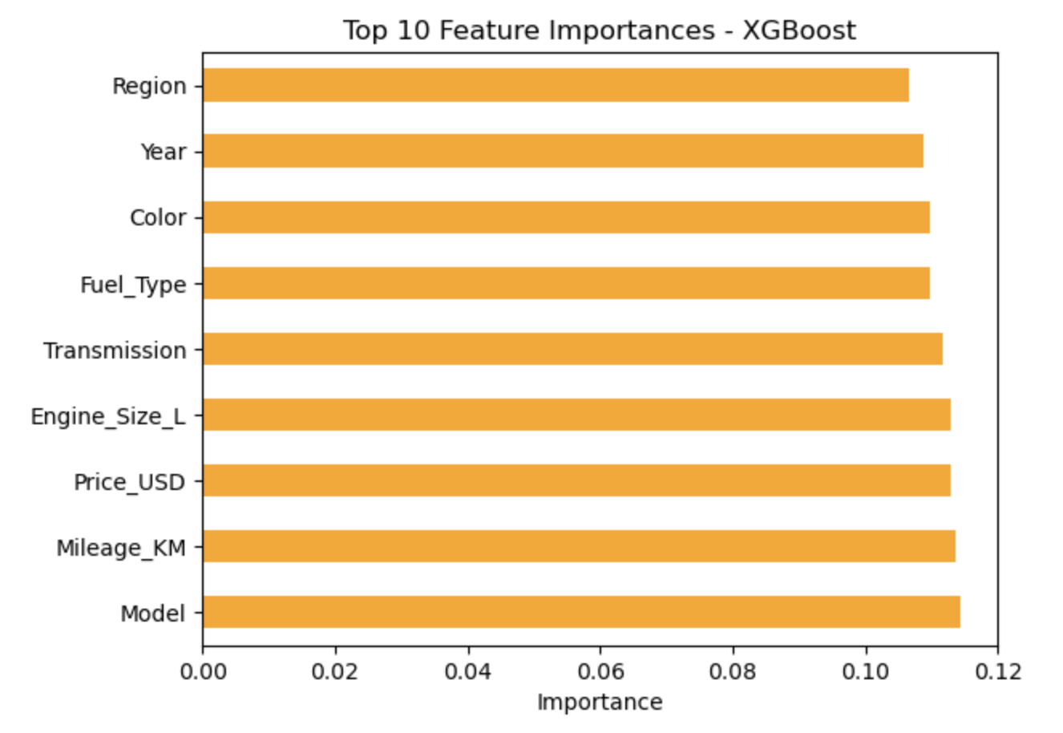

XGBoost Classifier
Accuracy: 0.68
Slightly better recall for “Low” class than Random Forest
Balanced feature importance
Still skewed toward dominant class
Stronger at learning from errors but not optimal for deployment
Feature Importance:
All features contribute relatively evenly to predictions.
No single dominating factors
Notes:
XGBoost is a gradient boosting algorithm, meaning it builds decision trees sequentially, with each new tree correcting errors made by the previous ones. It’s highly efficient and often outperforms other models in many classification tasks.
Here, XGBoost achieved 68% accuracy — very similar to Random Forest — but it showed slightly better precision and recall for the ‘Low’ class, meaning it was better at catching some of the harder-to-classify sales cases.
The feature importance plot for XGBoost was more balanced than Random Forest’s, meaning it spread its decision-making influence across multiple features rather than leaning heavily on just one or two. Still, Price, Mileage, and Engine Size were slightly more influential than others.
This balance can be a double-edged sword — on one hand, it’s more resilient to market shifts because it doesn’t over-rely on a single variable. On the other hand, it’s less targeted, which might make it less directly actionable for marketing compared to Random Forest.
So while XGBoost is excellent for general prediction performance, Random Forest might be more useful for dealerships that want clear, specific factors to focus on.

Slide 10

Conclusion
Random Forest and XGBoost outperformed Logistic Regression
Still struggles with class imbalance
Most Predictive Features:
Price
Milage
Engine Size
Random Forest is the most practical for dealership support
Notes:
Overall, Random Forest and XGBoost outperformed Logistic Regression. Price, Mileage, and Engine Size emerged as the most important predictors. For practical dealership use, Random Forest may be the better choice for targeted sales strategies, though improving class balance would help both models.

Slide 11

Assumptions & Limitations
Assumptions:
Kaggle data reflects real world trends
Patterns in the past remain relevant today
Limitations:
Class Imbalance → “High” dominates
No accounting for trends over time or buyer context
Limited to only BMW data
Notes:
The main assumption was that the Kaggle dataset reflects real-world BMW sales trends and that past patterns remain relevant today. Limitations included class imbalance, potential redundancy between features, and no consideration for time-based changes in buyer behavior.

Slide 12

Challenges
Low recall for minority class
Sales volume needed to be removed
Risk of biased models of not carefully monitored
Notes:
One major challenge was extremely low recall for the minority ‘Low’ class. Another was needing to remove sales volume due to its direct correlation with the target variable, which could have artificially inflated accuracy.

Slide 13

Recommendations
Use more class balancing techniques
Apply Hyperparameter Tuning
Extend model to other car brands
Deploy in dealership software for ongoing insihgts
Notes:
I recommend using class rebalancing techniques to improve predictions for the ‘Low’ class, hyperparameter tuning for better generalization, and expanding the approach to other car brands. Integrating these models into dealership software could help monitor changing trends over time.

Slide 14


Ethical Considerations
Models can reinforce existing biases
1
Maintain privacy and data anonymization
2
Use predictions as guidance, not as sole decision-makers
3
Notes:
We must be cautious about bias—models trained on historical data can perpetuate past preferences. It’s important to keep buyer data anonymous and to treat model outputs as guidance rather than strict rules.

Slide 15


Thank You
Notes:
Thank you for your time. I’m happy to answer any questions you have about the methods, results, or applications of this project

Slide 16
References
Chen, T., & Guestrin, C. (n.d.). XGBoost documentation. Retrieved July 22, 2025, from https://xgboost.readthedocs.io/en/stable/
Junaid512. (2023). BMW Car Sales Classification Dataset [Data set]. Kaggle. Retrieved from https://www.kaggle.com/datasets/junaid512/bmw-car-sales-classification-dataset
Lundberg, S. M., & Lee, S.-I. (2017). A unified approach to interpreting model predictions. In Advances in Neural Information Processing Systems (Vol. 30). https://arxiv.org/abs/1705.07874

